Slide 1
He Died While Getting Shot
9 painful ways to mess up cause and effect
Dan Allen
LUW Spring Conference 2018

Slide 2
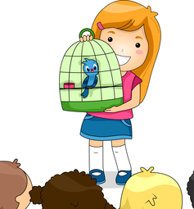
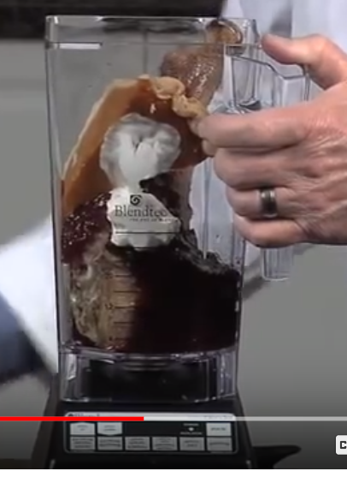
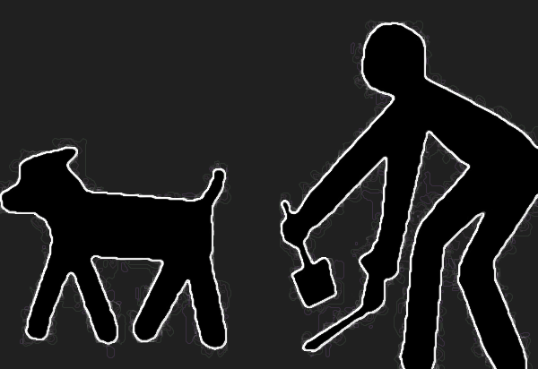
The Foreshadowing Slide

Slide 3
He died, while getting shot. And I was knocked down and couldn’t stop the villain from pulling the trigger. The tall guy that got me really packed a punch. I felt the glass on the ground from the broken chandelier that fell when I pushed it towards the gunman who shot Dale.
I decided it was time to go. I was feeling uncomfortable from all the bleeding from my fat lip. That’s where he hit me first. Pow. I was mad. It hurt. And my head snapped back while being punched when the fight started.

Slide 4
Writing B.A.R.F.
Bad Action-Reaction Framing

Slide 5
You may now open the B.A.R.F. bags supplied for this session

Slide 6
Disclaimer
Examples of “bad” writing are inspired by manuscripts I was a beta reader for.
People never give permission for their writing to be used as a bad example, so I have to rewrite the passages, keeping the same mistake, but attempting to make the passage unique.
Any association to unpublished works is unintentional.

Slide 7
What’s wrong here?
Effect
There was yelling and smoke as the flashbangs exploded.
Cause

Slide 8
Culprit: Time Travel
Cause AFTER effect places a large mental burden on readers.
Common with passive construction “There was…”
Be careful with “AS” and “WHILE”

Slide 9
What’s wrong?
He can't be moved, not now. I don't know if he'll be able to be moved at all.

Slide 10
Culprit: Déjà vu dialogue
We naturally repeat ourselves.
If we repeat ourselves with subtle differences it confuses readers.
Good writing doesn’t often repeat thoughts. (see I just did it and it bugged you)

Slide 11
Déjà vu Fix it
He can't be moved, not now. I don't know if he'll be able to be moved at all.

Slide 12
Déjà vu Fix it
He can't be moved, not now. I don't know if he'll be able to be moved at all.
I don’t think he can be moved.

Slide 13
Déjà vu Fix it
He can't be moved, not now. I don't know if he'll be able to be moved at all.
I don’t think he can be moved.
You try to move him and he’ll die.

Slide 14
Ok or not?
The injured dragon turned away. It wouldn't be a problem anymore.

Slide 15
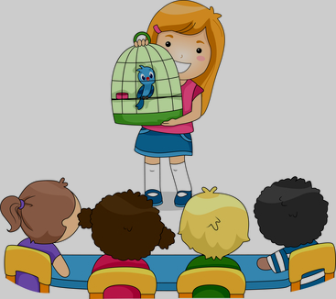
Culprit: Kindergarten
Show AND Tell = readers want to strangle you
Fix with show and show (action and reaction)

Slide 16
Kindergarten Fix: Show (action) and Show (reaction)
“It wouldn't be a problem anymore.”
(show this via POV’s reaction)
The injured dragon turned away. Ella released her white-knuckle grip on the gunwhale and let out the breath she had been holding. “It’s gone.” Her hands began to shake. She clutched them together but couldn’t stop the trembling. I almost died, she thought as a sob broke over her like a storm wave.
I almost died.

Slide 17
From Stephenie Meyer’s Twilight
“The Cullens don’t come here,” he said in a tone that closed the subject, ignoring her question.
I stared at the deep-voiced boy, taken aback, but he was looking away toward the dark forest behind us. He’d said that the Cullens didn’t come here, but his tone had implied something more—that they weren’t allowed; they were prohibited.

Slide 18
Name the culprit
She slammed the metal handle on the man's face and knocked him out.

Slide 19
Culprit: Whose line is it anyway?
Separate actors need separate lines

Slide 20
“Whose line” Fix
She slammed the metal handle on the man's face and knocked him out.
She slammed the metal handle on the man's face. He went down hard and didn’t move.

Slide 21
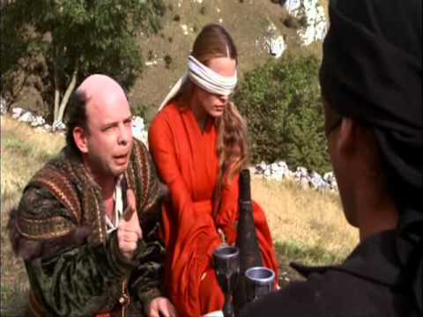
What’s wrong?
“Mel was gone before Gavin could give an answer either way. He seemed like an easygoing fellow, and Gavin wondered if Anna realized she had already added the man to her list.”

Slide 22
Digest this.
Ava thanked him and went back to her job. She didn’t notice when he continued to watch her. It was kind of her to install the chair for him. He wondered if she realized she wore her emotions on her sleeve.

Slide 23
Culprit: Blender
Readers can only focus on empathizing one emotion/conclusion at a time
Don’t blend separate dishes
Thanksgiving Shake:
Turkey leg w/bone
Cranberry sauce
Pumpkin pie

Slide 24
Blender Triage
Typically caused by excessive tell-style narration
Identify the main emotion that is developing in the scene
Focus on helping the reader to experience that. Let other things go.

Slide 25
Another subtle one
She was surprised when someone fell past her. The man thunked on the ground below. He groaned, so they weren’t high enough to kill anyone by throwing them off the ship.

Slide 26
Feel it yet?
She took another step forward and the men still hadn’t tried to attack. Maybe going around without a disguise was a good idea. If she had been dressed as a boy, she would have been mugged already.

Slide 27
Culprit: Pooper Scooper
“pooper scooper”= always cleaning up after your characters
Similar to Time Travel (effect before cause), but more subtle: conclusion before reason
Often caused by “belated foreshadowing”
Sometimes relics of cut and paste editing

Slide 28
“Pooper Scooper” (mate in 1)
There was only one place to get the kind of magic he needed.
Terras looked ahead to where the forest grew denser with the leaves covered in grey-green mildew. Below the canopy almost no light reached the ground.
Without a touch of darkness to fuel his unique brand of magic, Terras couldn’t hope to find the princess.

Slide 29
Fixed
Without a touch of darkness to fuel his unique brand of magic, Terras couldn’t hope to find the princess.
There was only one place to get the kind of magic he needed.
Terras looked ahead to where the forest grew denser with the leaves covered in grey-green mildew. Below the canopy, almost no light reached the ground.

Slide 30
Awkward moments
(her) "You aren't gone yet."
(him) "No, but I will be." He raised a hand to her cheek; the touch was like a feather on her face.

Slide 31
Culprit: Hometown Fireworks
Write like a fireworks show
Save the biggest bang for last
(not like your home town that lights the big one first and then little fireworks one at a time)

Slide 32
Action or words first?
“I will never love you” $↔$ [She slaps his face.]
“This is all you get.” $↔$ [He puts a coin on table.]
“I have something to confess.” $↔$ [She takes his hand in hers.]
“Did you ever even care about your father?” $↔$ [Slams the door/walks out.]
(Which is the bigger statement?—put it last)

Slide 33
What is wrong with Kat?
Karyn stood by her father’s bedside as he drifted back to sleep. Then in one blink he was gone. She stilled, waiting for his chest to rise again and looked away when it didn't. Never had she thought she would be truly alone in this world, taking a breath she turned back and placed a kiss on his brow.
The door opened and she jumped slightly, but only found Elaina standing at the door. Elaina had always been the rock when she was around. Something had happened to have her so worried. She had been out all day, she shouldn't know how ill the king had turned.
Notes:
You are cutting to effect without the cause. “She listened to his ragged breathing, waiting in suspense for each successive labored breath, each softer than the next…” Drag me through this moment. Slow time down, as you would for a knockout punch in a fight. He lets out a long breath. Everything is still. “Father?... Father!”
Then the tears come, the shaking, the grief. The denial. The weakness. Take use to a dark place here, a place where we can learn to what to expect when we face this situation with our own parents. Take us deeper than we want to go. Drag us down. Shatter our world. She tears whatever is in her hands. She has a panic attack. She looks for some escape, but finds none. She grabs his hands, tries to squeeze life into him. She begs him. “please, no. Please, daddy, come back. Please…please.”
Make me CRY and I will never put the book down.
BTW, we still have no idea who Lorin is and how he relates to her. It would help if you use her brother’s name when he is mentioned so we don’t assume Lorin is her brother, and also giving Lorin a title might help.

Slide 34
Culprit: Zombie Brains
Reveal information in the order we evolved to experience it.
Then we experience the story from the character’s POV
…Not the way zombies with mush for brains experience it all at once or missing parts entirely.

Slide 35
This is your brain.
Step 3: Cognitive
Step 2: Emotional
Step 1: Physical

Slide 36
From James Patterson’s Haunted
He (the bad guy) sprang back, but he still had the gun in his hand. Now I had an overturned table to duck behind as he fired a round. I felt the impact on the heavy wood.
The sharp blast in the hushed silence of the library was startling. Nothing like this had ever happened before in Butler Library. The effect was immediate. I heard screaming and saw students starting to scatter.
Now I had a pistol in my hand…
…There were more screams. I had to trust that the security guard, Todd, was already on the phone calling for help. Right now it was my job to make sure no bystanders got shot, but I couldn’t let this kid get away, either. He wasn’t just a killer: he was the key to breaking this drug ring and stopping the killing.
…Then I lost sight of him completely. I was worried about stumbling into an ambush. That’s what I would do—stage an ambush—if I were as desperate as Diego was. I paused at the end of a long line of books. I took in a couple of breaths and focused.

Slide 37
A new one!
Opening her eyes she found hazy yellow sunlight flickering through the cracked ceiling. She blinked – that wasn't right. The office was on the second basement floor. Another floor was between her and the outside. Wreckage from the room lay around her. Dusty fragments of ceiling covered her. One of the computer desks had tipped over along with an old filing cabinet that now didn't look anything like it had. All of it pressed down on her already aching body. A cool wind came in from behind her; she couldn't move yet to see why.

Slide 38
Culprit: Out-of-body Experience
Aka Outside-In
When we experience the world closest to us first and then move outward, the reader is rooted in the experience.
When we move from outside-in, the reader is having an out-of-body experience until we get to the POV location.

Slide 39
Fix It: your turn
Opening her eyes she found hazy yellow sunlight flickering through the cracked ceiling. She blinked – that wasn't right. The office was on the second basement floor. Another floor was between her and the outside. Wreckage from the room lay around her. Dusty fragments of ceiling covered her. One of the computer desks had tipped over along with an old filing cabinet that now didn't look anything like it had. All of it pressed down on her already aching body. A cool wind came in from behind her; she couldn't move yet to see why.

Slide 40
Find it
Trying to stand, a gasp of pain slipped past her lips and she dropped back to the ground. Her left ankle felt worse than she first thought. A glance at the ankle showed no bone showing, but she wouldn't know if it was broken until she got up and moved.
Blood ran down the side of her neck and she wiped it off without much thought. Sharon levered herself to her feet and balanced on her good leg for a second before testing the injured one. Pain yes, but it wasn't broken. After breaking her ribs eight months ago, she'd know the feeling again. She reached up to touch a tender spot on her forehead through her short hair. A massive goose egg was already forming.
Great, she thought. Now she would have to deal with a concussion, on top of looking like she was turning into a unicorn.
Time Travel
Deja vu
Kindergarten
Whose line
Blender
Pooper Scooper
Fireworks
Zombie Brains
Out-of-body

Slide 41
Name that culprit
The silence weighed on her; where were the people fighting to get out of this building.
Time Travel
Deja vu
Kindergarten
Blender
Whose line
Pooper Scooper
Fireworks
Zombie Brains
Out-of-body

Slide 42
Find it. Fix it.
The air rippled and pulsed as though with a life of its own, a life that was strangely disturbed. Dave watched the CEO fall away from his friend, who also fell. Rushing forward, he caught James’s body before it hit the ground, while calling out to Nancy. His voice disappeared in the cacophony of sound. Many employees were instantly by her side so Dave focused all of his energies on his friend.
Time Travel
Daja vu
Kindergarten
Blender
Whose line
Pooper Scooper
Fireworks
Zombie Brains
Out-of-body

Slide 43
A few quick changes and…
The air rippled in a powerful pulse. The blast slammed slamming Dave back into the wall. A throbbing ache spread through his skull. He cradled his head in his hands. Ears ringing, his vision blurred, Dave fought off a wave of vertigo. But he was still alive—still standing.
As the pain in his head mounted, Dave looked to the spot where the CEO and James had stood. Both were sprawled out on the floor, motionless. “James!”
Dave rushed to his friend’s side and cradled his limp body.
“Nancy,” he cried. “Help, please!”
His voice disappeared in a cacophony of sound as servants crowded around the fallen CEO.
Dave looked at his friend. His stomach twisted into a knot. Please no.
“James—hey! Come on. Don’t leave me.”
His friend didn’t open his eyes.

Slide 44
Review

Slide 45
Contest: Best causality violation

Slide 46
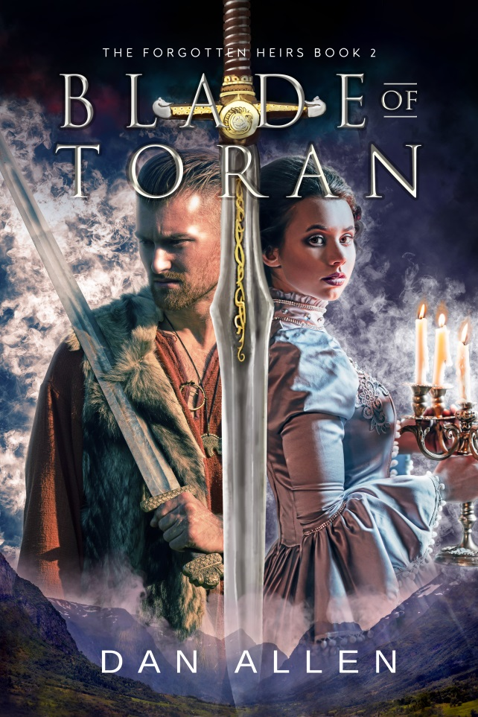
Let’s Connect
More: YouTube “Scifi fantasy fun channel”
www.AuthorDanAllen.com
Coming in 2018:
Dungeons of Arcadia (MG Fantasy, Future House Publishing/Ninja Division)
Arachnomancer (YA Fantasy, Dragon Scales Publishing
Science in Fiction (Writer’s Digest, editor Dan Kobolt)

